Slide 1

Toolkit Doc23 Spine E-chain
Sept20, 2010

Slide 2
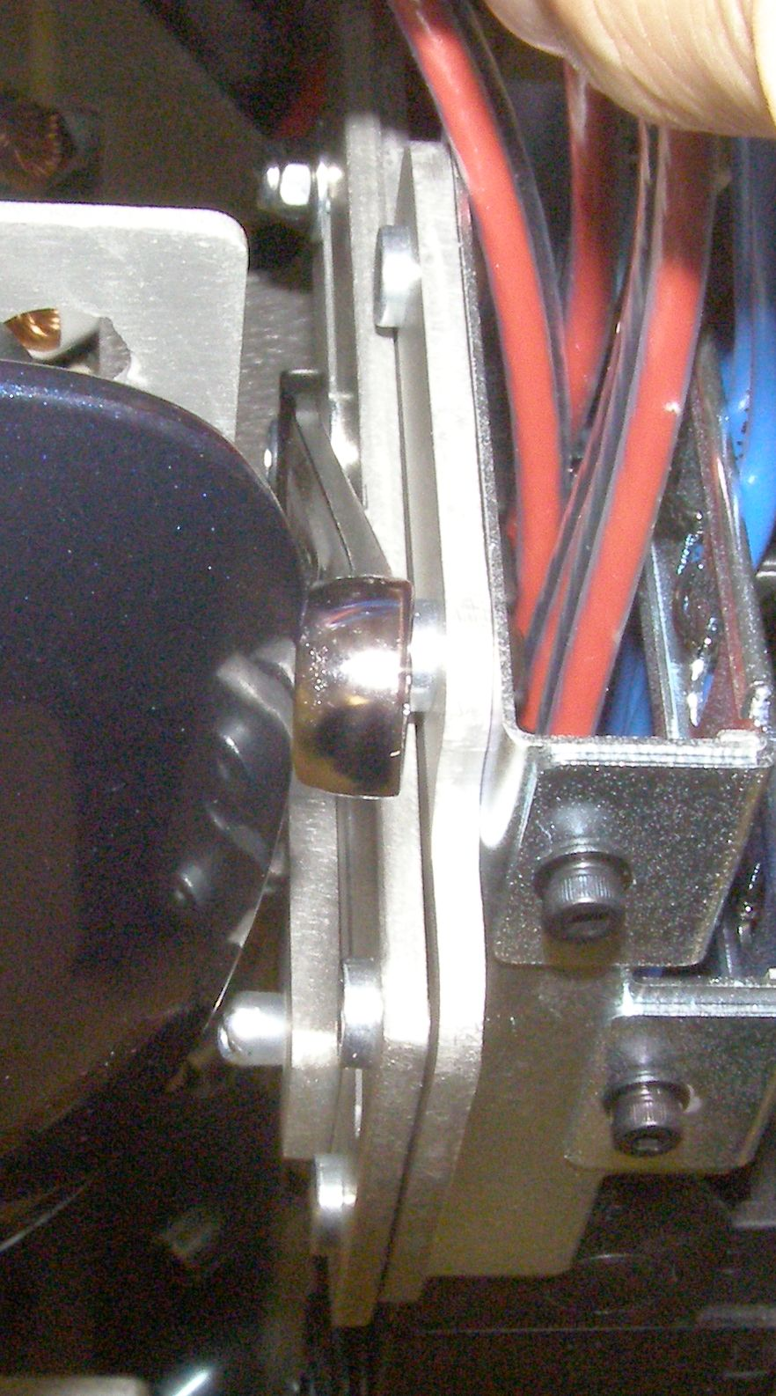
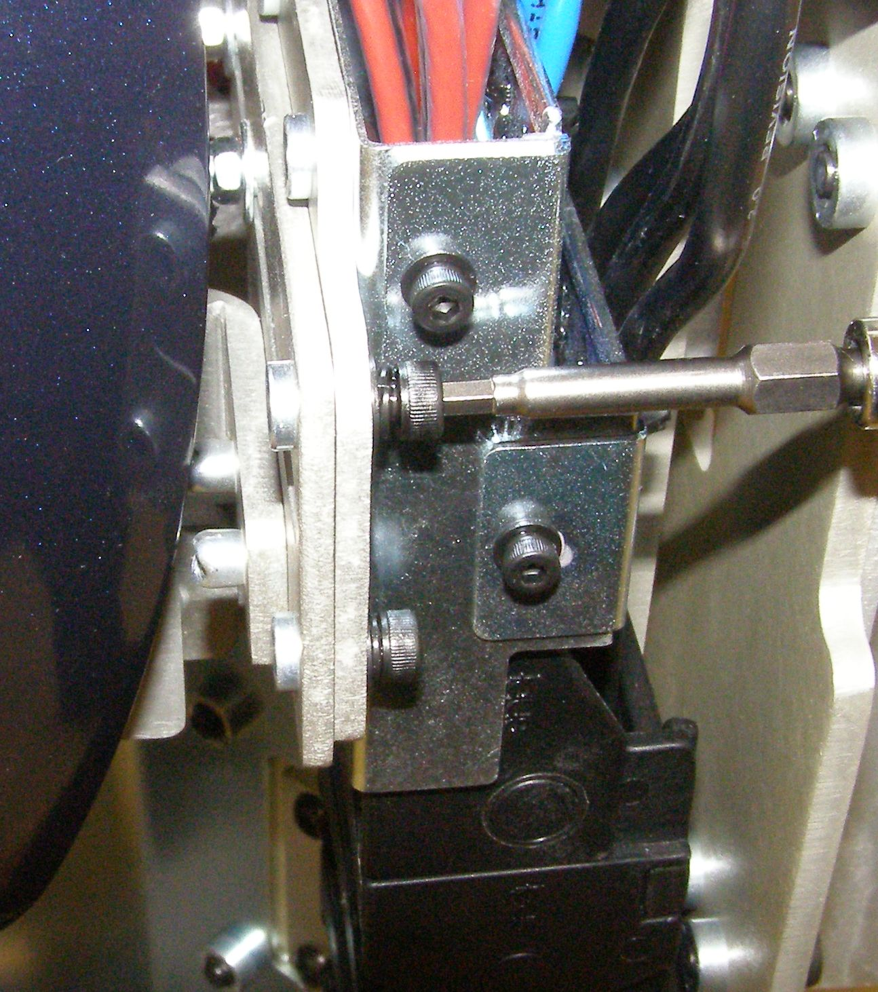
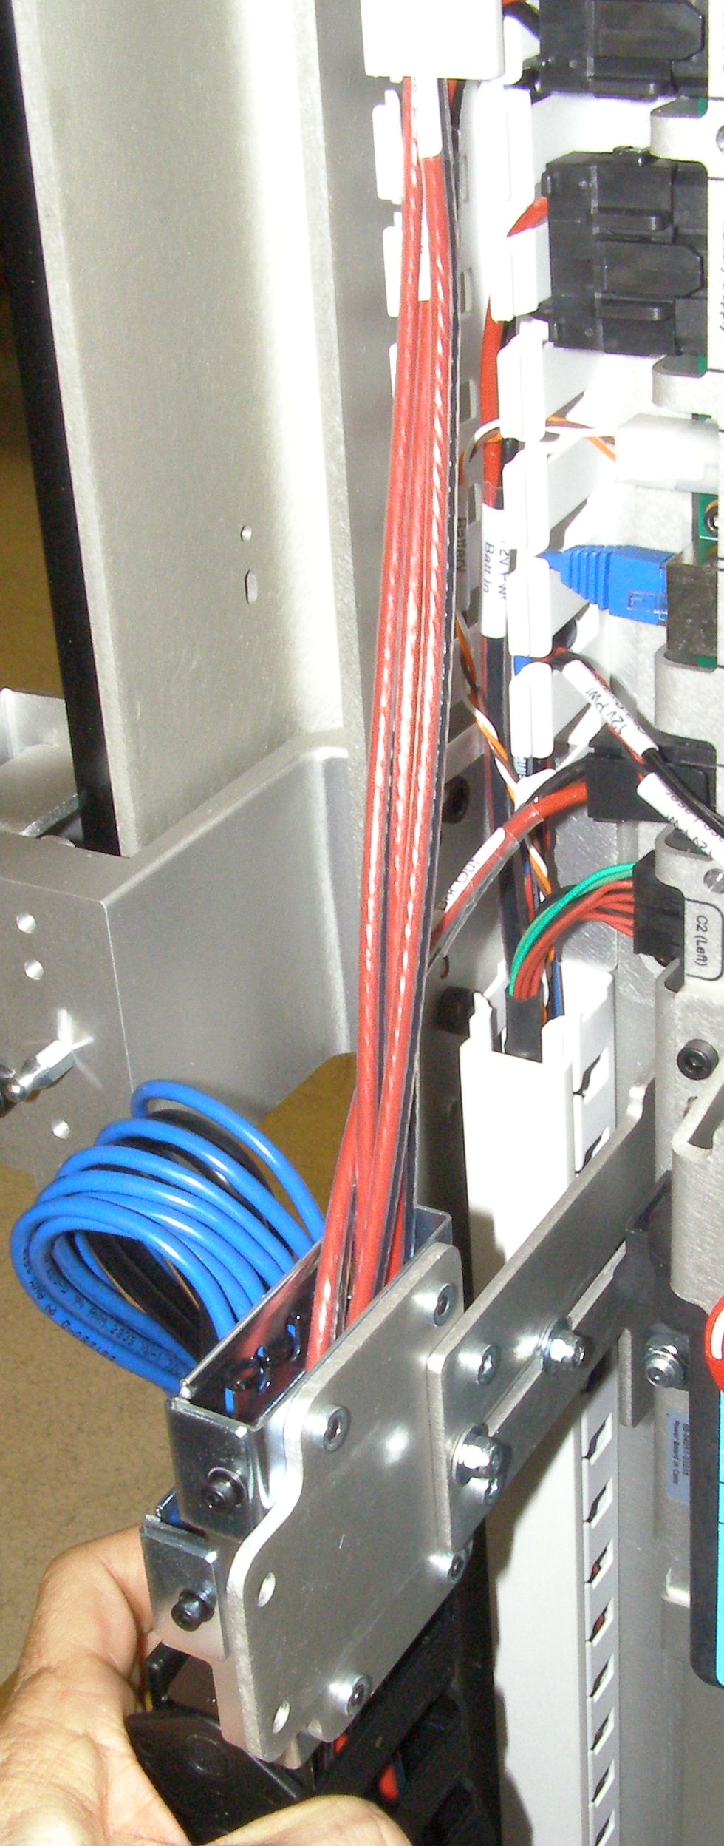
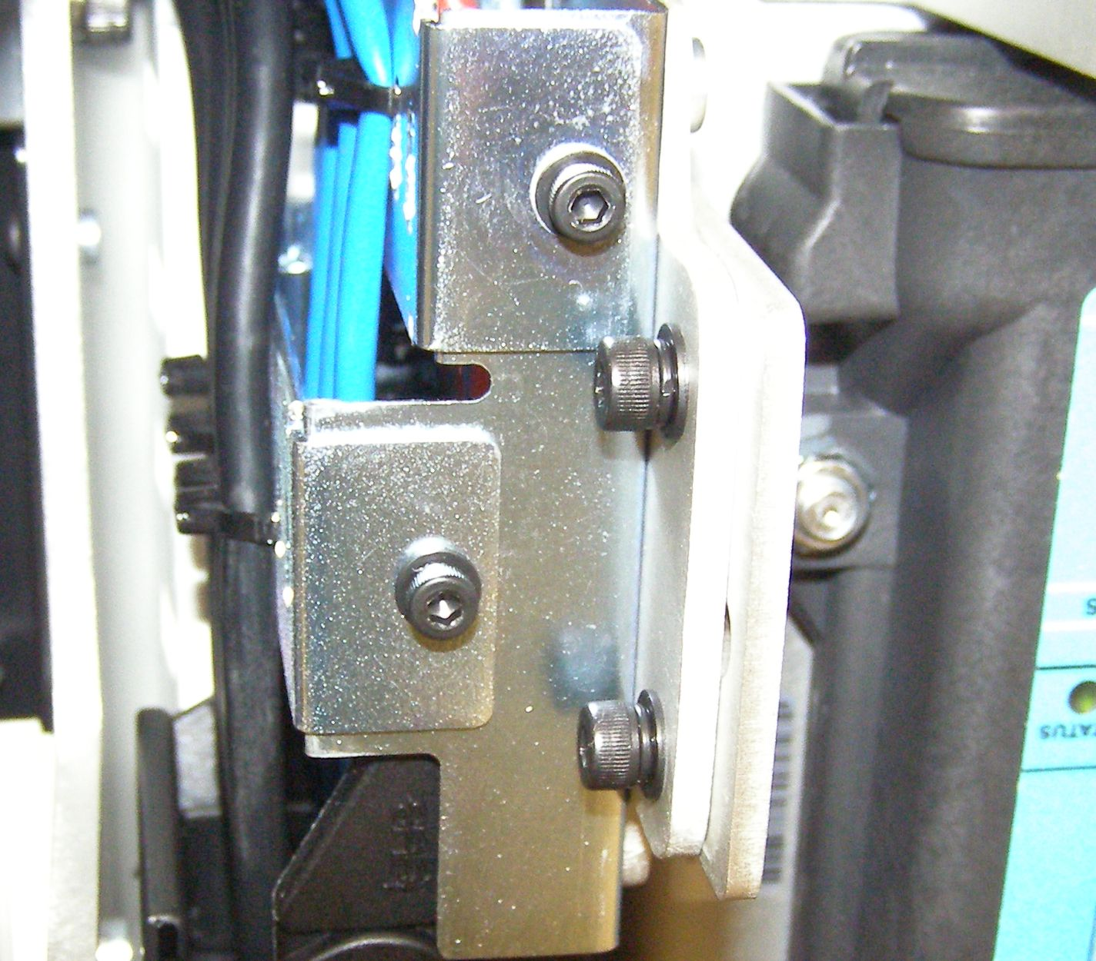
Spine E-chain Cable Install
Make sure the Robot is turned off and unplugged from wall power.
Remove the Rear Bottom Panel. (Doc2)
Remove the Rear Bellows. (Doc9)
Using the 3mm bit together with the T-handle driver, remove the 2 locking screws at the top of the E-chain and 2 at the bottom. (Fig. 1,2)
At the top of the E-chain, try to slide the E-chain out and if necessary using a 7mm open end wrench (not provided) loosen the 2 7mm Nyloc nuts to allow the bracket with E-chain to slide out. Do this for the other end, first sliding the Cable Channel Cover up out of the way. (Fig. 3,4)
Fig 3
Fig 4
Fig 1
Cover
Fig 2

Slide 3
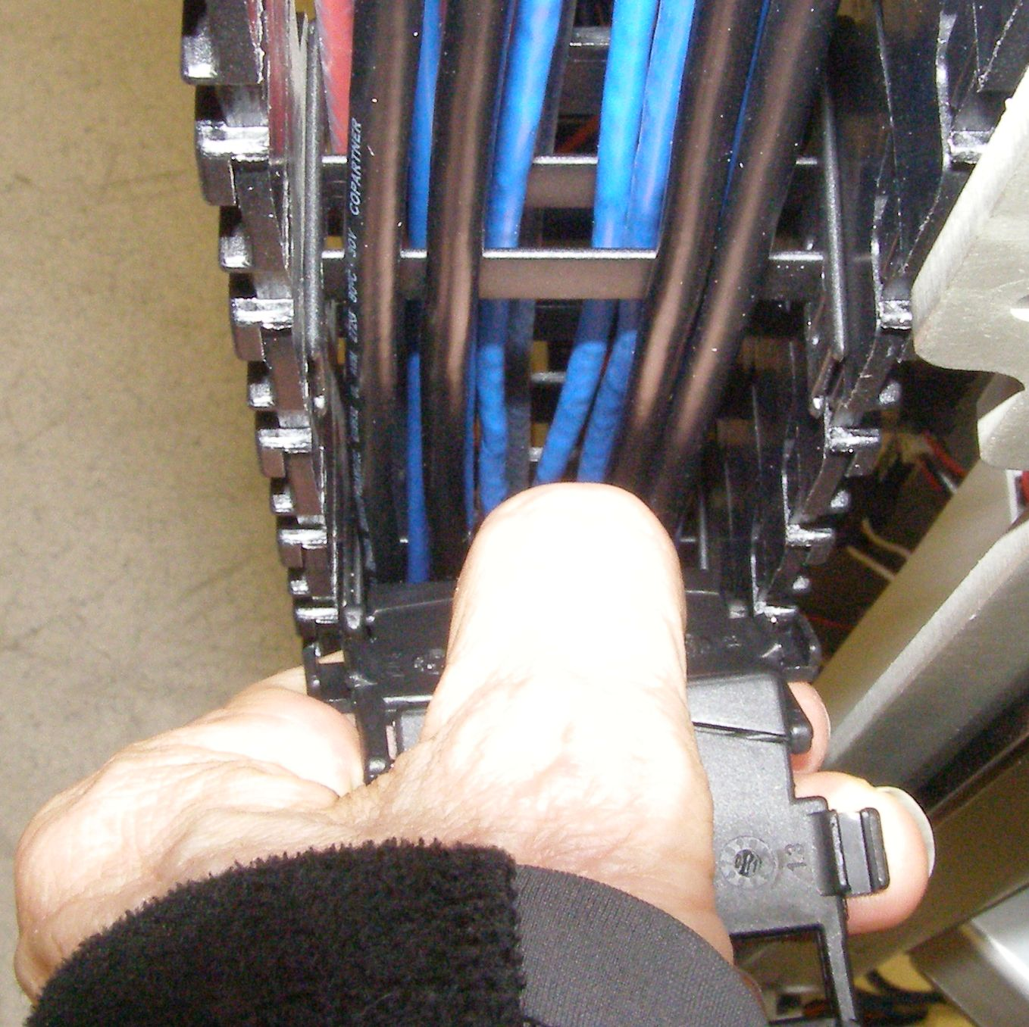
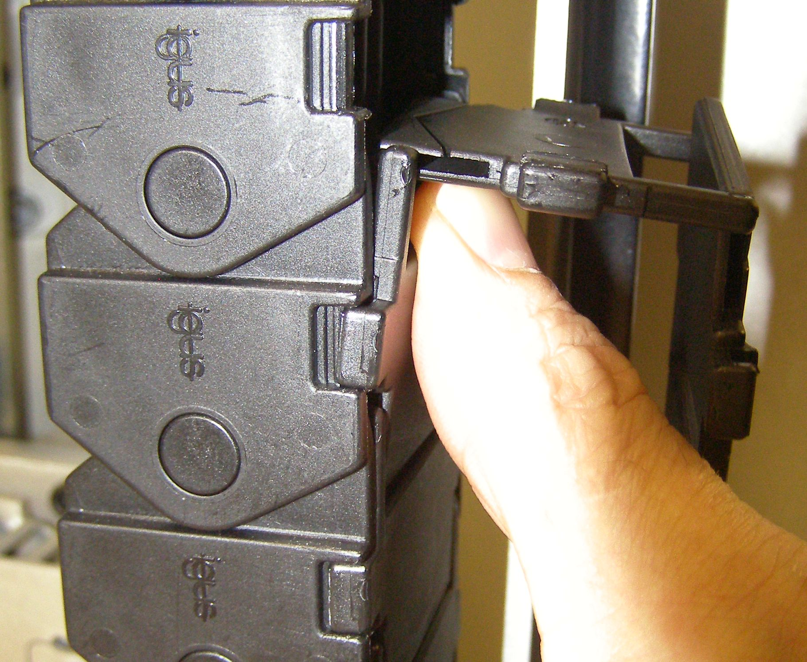
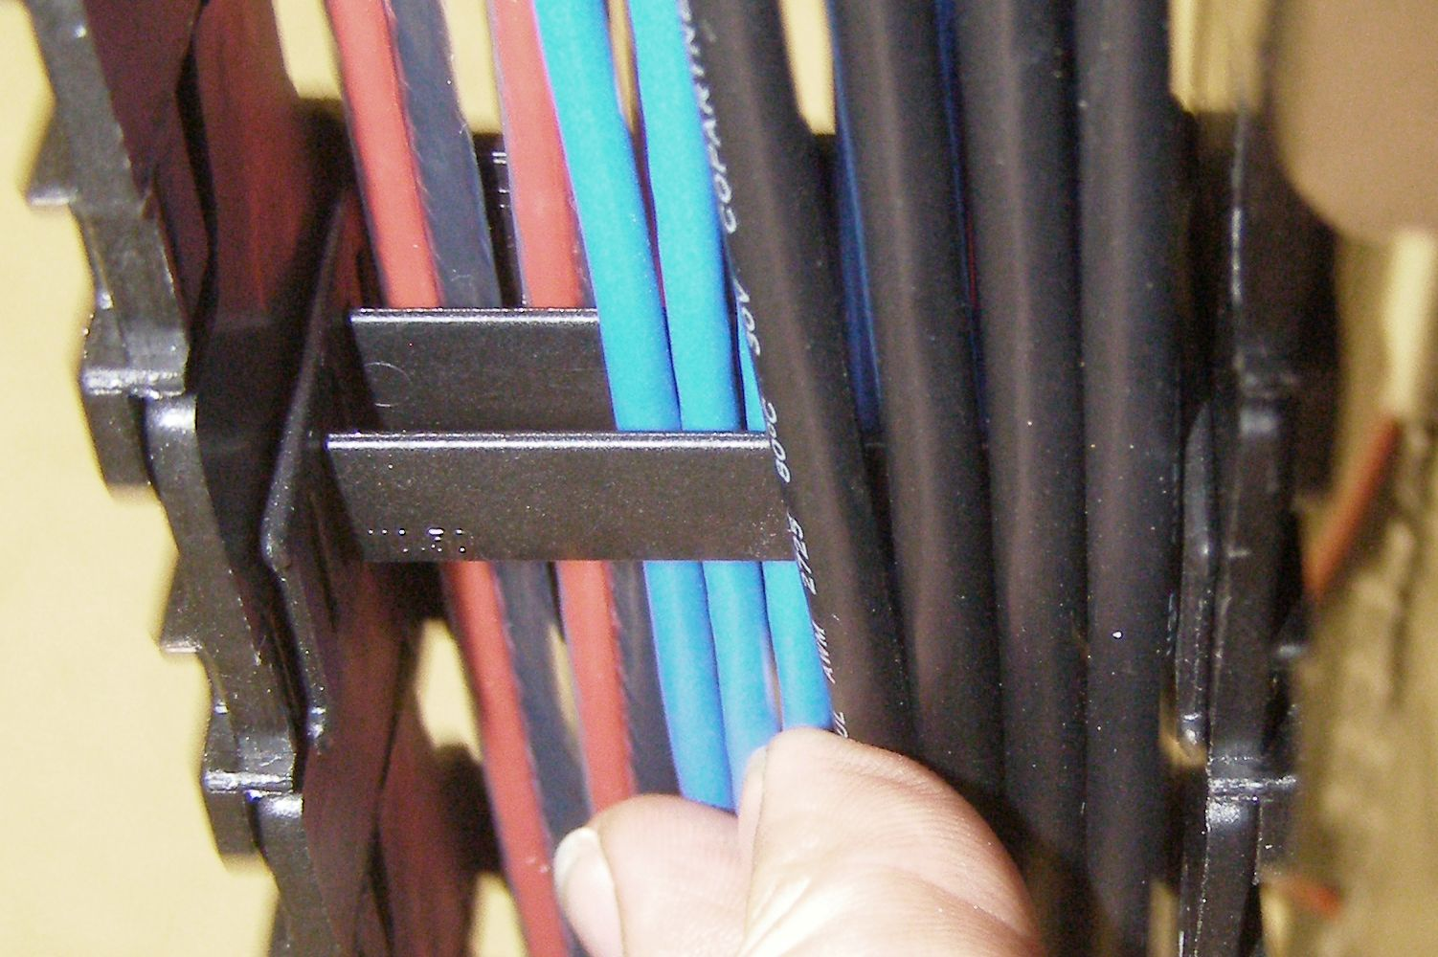
Spine E-chain Cable Install
Starting at the top, carefully snap out the outside E-chain links. They are linked together but can come apart if you are not careful. (Fig. 5)
There are 3 levels of channels. It is recommended to run any additional cables on the outside channel. (Fig. 6)
After you are done running cables, carefully snap the E-chain links back in place one at a time. (Fig. 5)
Slide the E-chain back into place and using Loctite 248, install the 4 screws and torque to 1.36Nm.
If necessary tighten the 4 Nyloc nuts until the washers are not loose.
After you are done running cables, carefully snap the E-chain links back in place one at a time. (Fig. 7)
Slide the E-chain back into place and using Loctite 248, install the 4 screws and torque to 1.36Nm.
If necessary tighten the 4 nyloc nuts until the washers are not loose.
Reinstall the Rear Bellows
Reinstall the Rear Bottom Panel
Fig 7
Fig 5
Fig 6

